Slide 1

Introduction to NLP
Raghav Bali

Slide 2
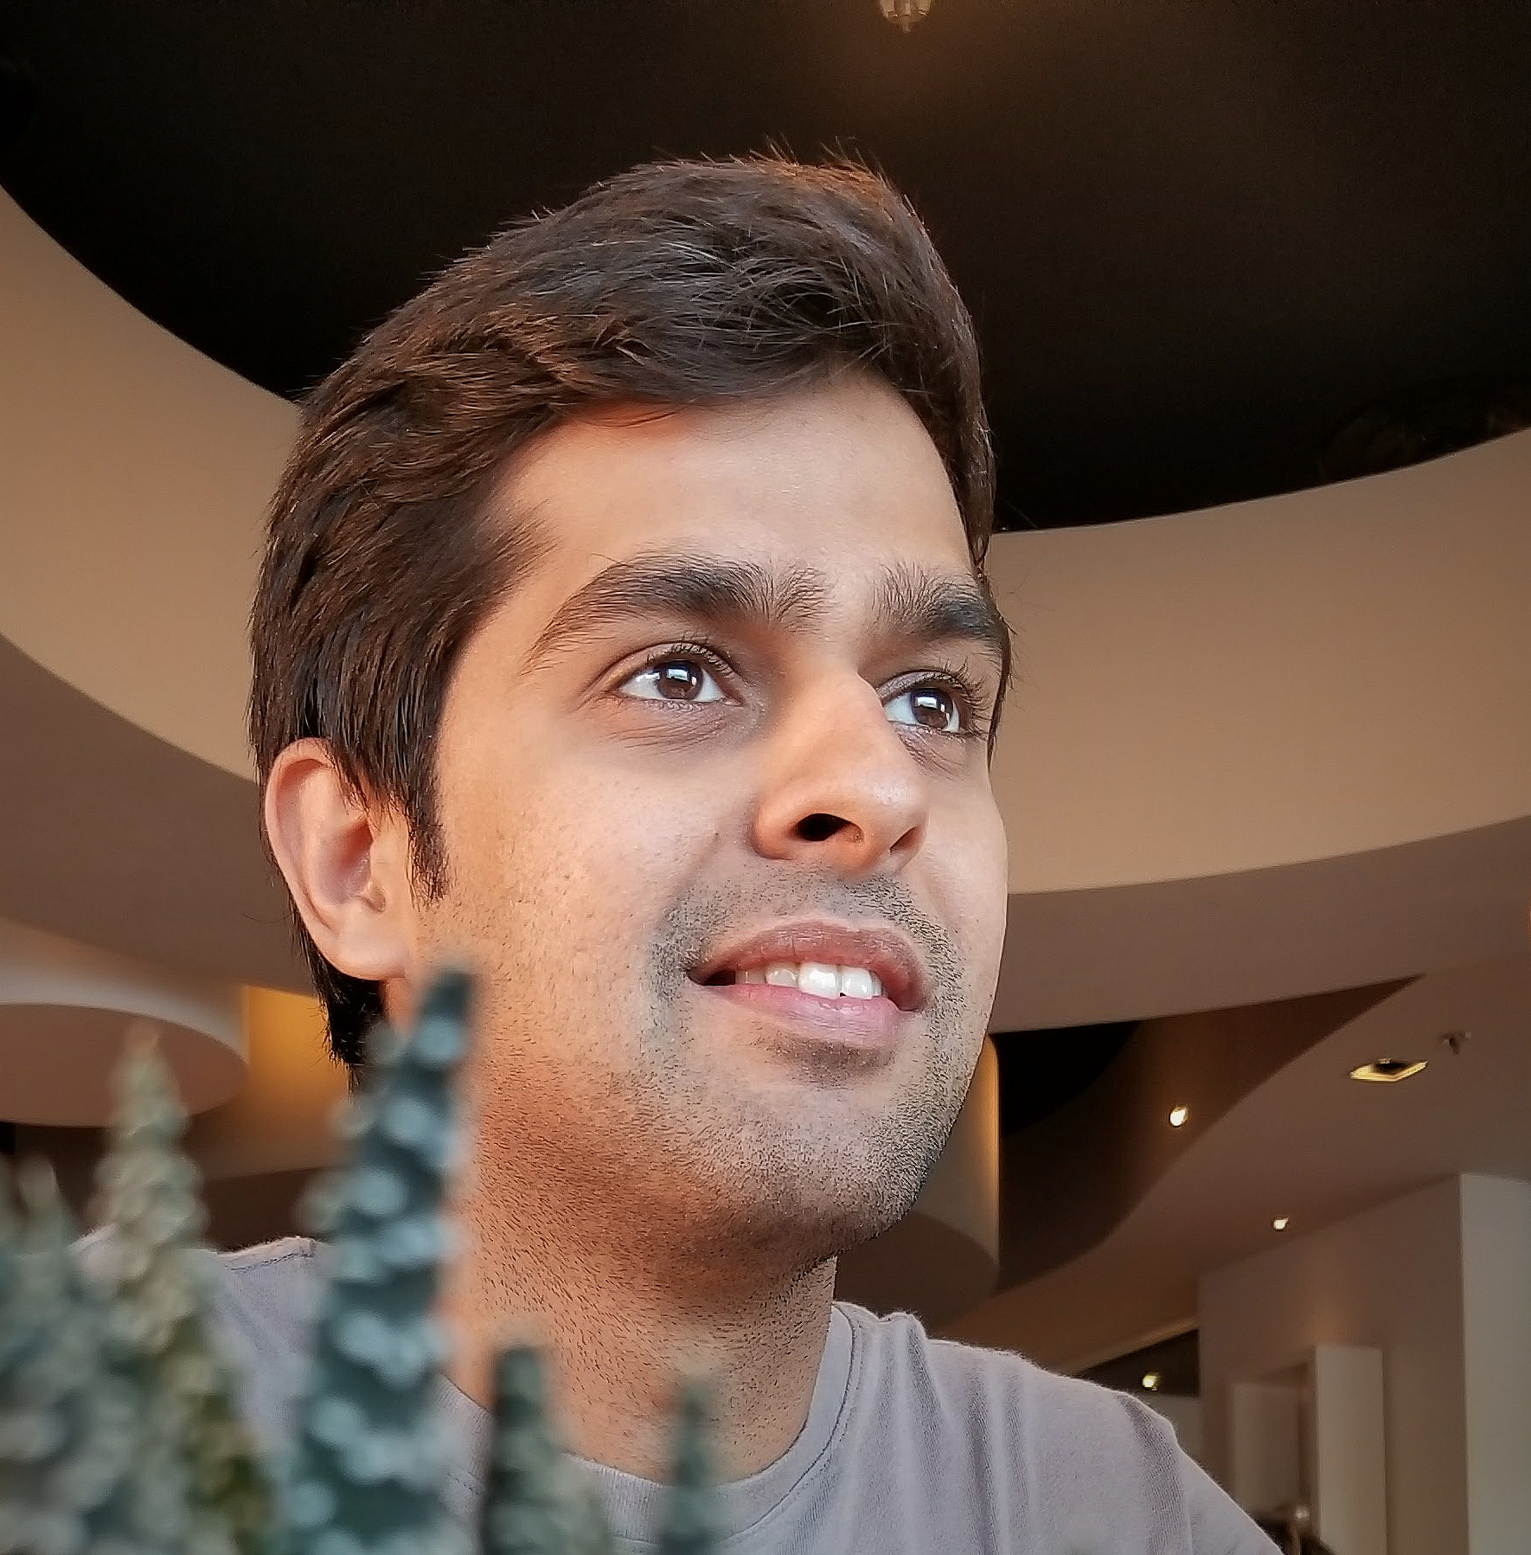


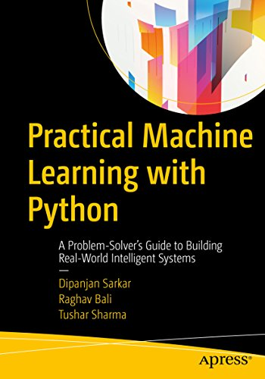
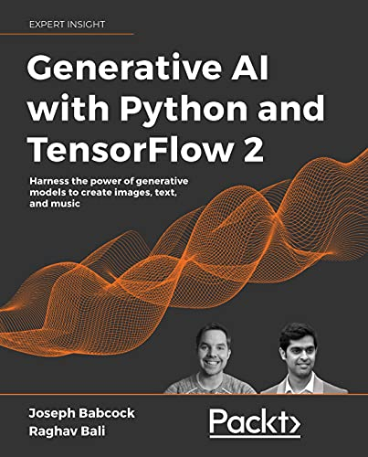
Raghav Bali
Staff Data Scientist
Author of Multiple Books
Inventor with 7+ patents
Speaker at Top Events

Slide 3
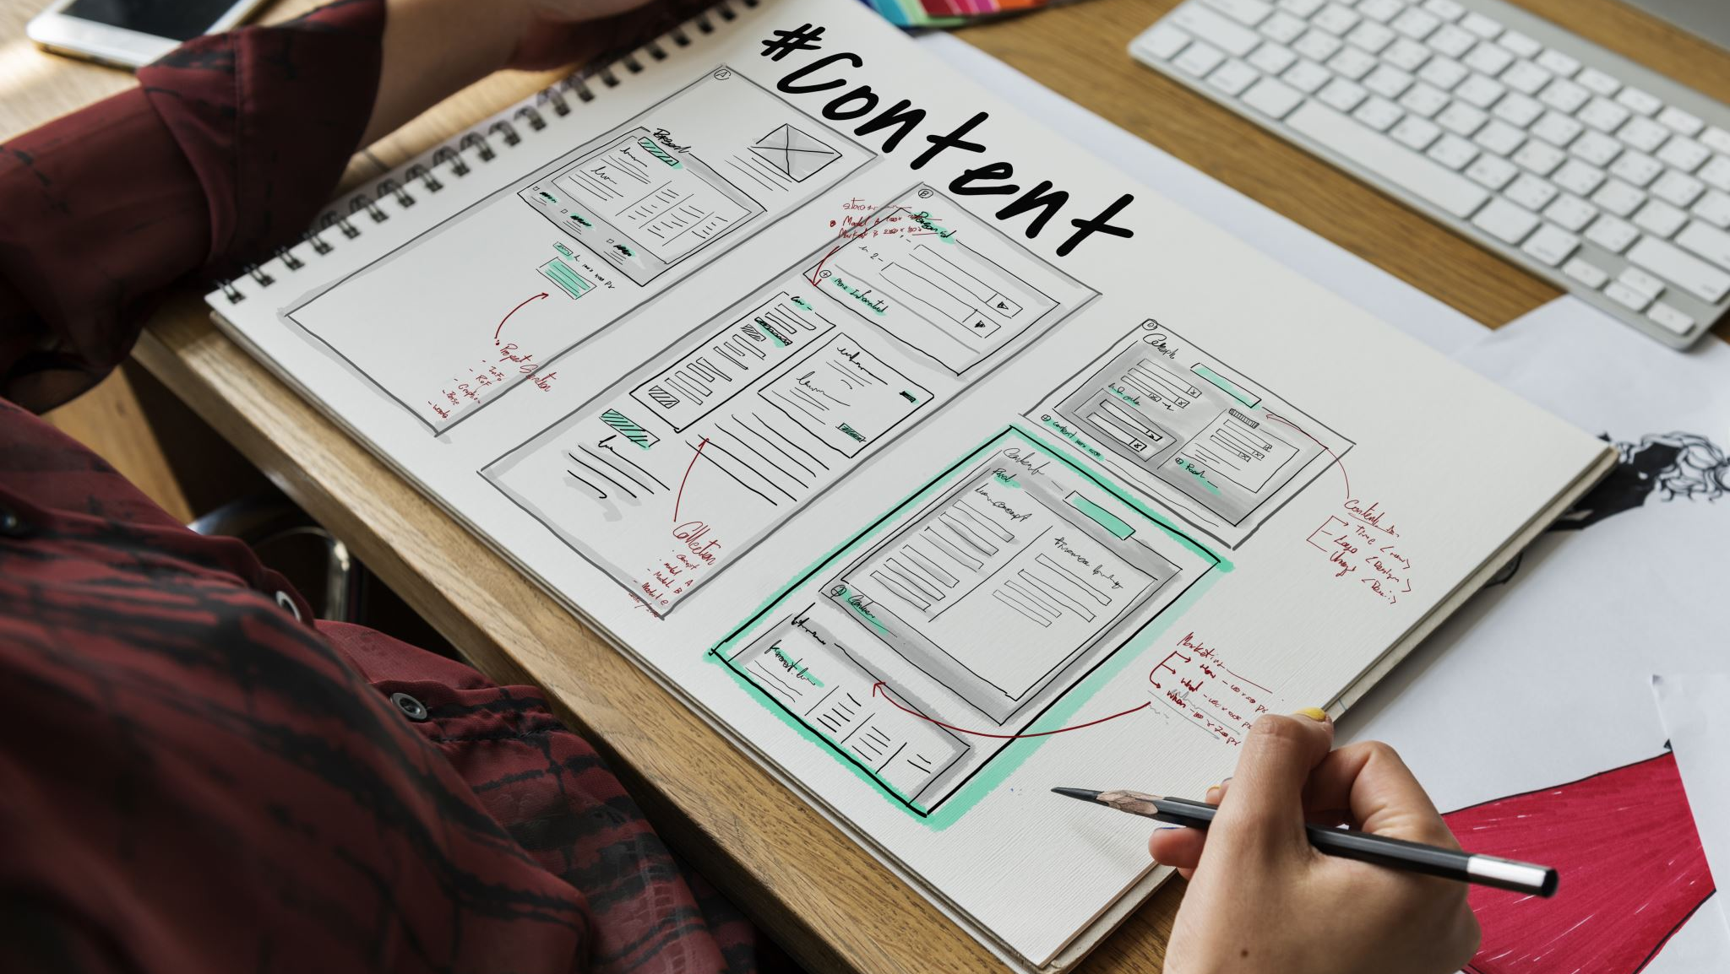
Agenda
What is NLP
Applications of NLP
Complexities
NLP Workflow

Slide 4

Natural Language
Highly unstructured in Nature
Way of Communication
Too many variations
Difficult to Ingest/Parse
Available all around us

Slide 5

What is NLP

Slide 6
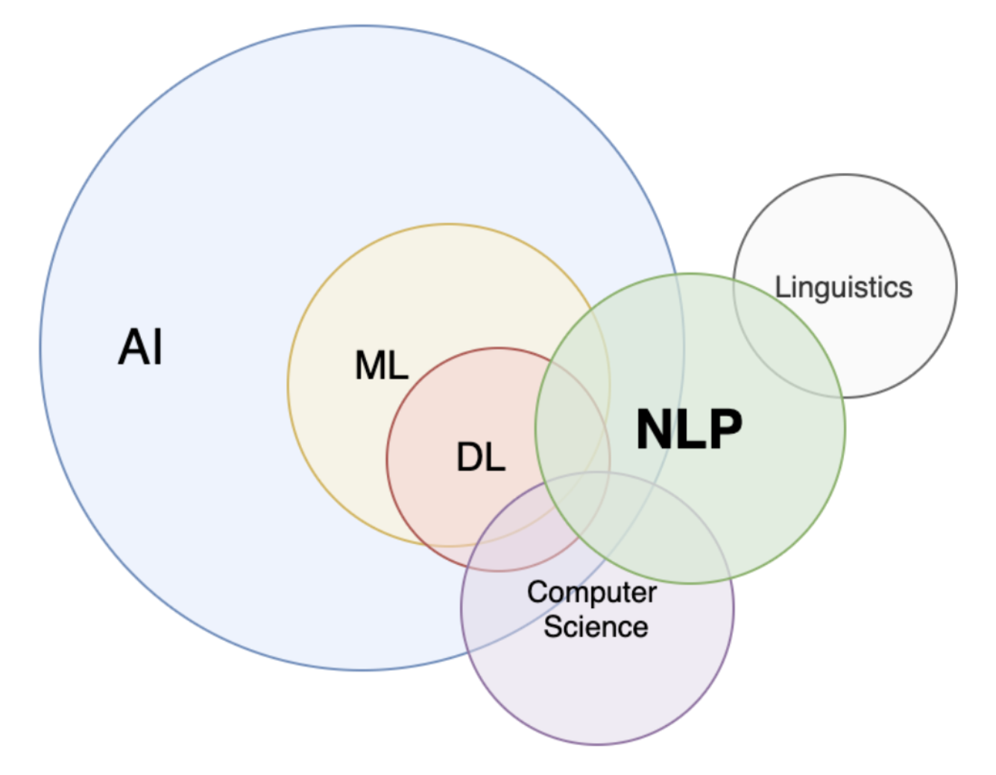
What is NLP?
Intersection of :
Linguistics
Computer Science
AI
NLP is about:
Processing text
Analyzing unstructured information
Understand, Generate and Communicate

Slide 7







Applications
Text Classification Sentiment Analysis, Spam Detection, Document Categorization
Information Retrieval Search, Chat-bots, Question Answering
Text Summarization News Excerpts, Document/Book Summary, Topic Modeling
Machine Translation English to Hindi, German to French…
Text Generation Creative writing, Headline creation, Meme text
Speech Analysis AI Assistants, Speech to Text

Slide 8

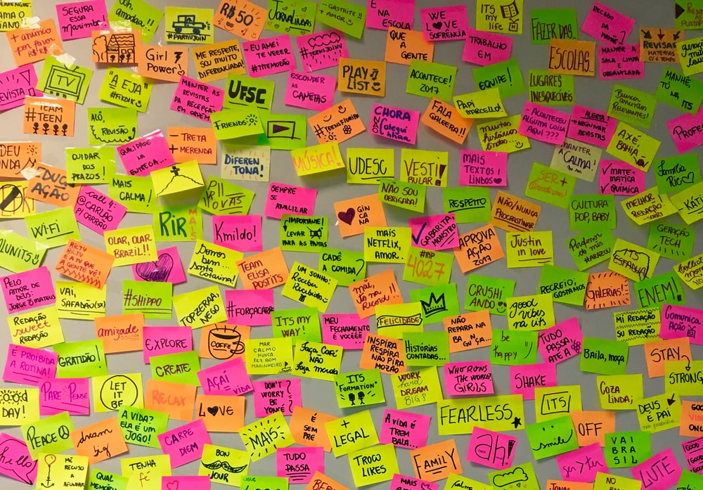
Language and its Complexities
Languages are complex and have fuzzy grammatical rules and structures.
Every Language is defined with a list of characters called the alphabet, a list of words called the vocabulary and a set of rules to use the words called grammar.
Most learning algorithms are designed to work with numbers, matrices, vectors…

Slide 9
Typical NLP Workflow
Preprocessing
Cleanup
Standardization
Feature Engineering
Tokenization
Text Representation
Modeling
Train
Evaluate and Deploy

Slide 10

Time for Some Action
Hands-on Time

